Slide 1
Exemptions
Pub 4012 – Tab C
Pub 4491 – Part 2 – Lessons 6 and 7
Notes:
Two Hidden Slides
#47 removed reference to prior software in speaker notes
1

Slide 2
Caution!
Exemptions and Filing Status encompass some of the most complex tax law issues
Determining whether taxpayer has a “Qualifying Child” or a “Qualifying Relative” is of prime importance
We’ll go over the rules first, then show you an easy way to apply them
Notes:
2
As discussed in previous lesson –
The correct filing status can impact many areas of the return

Slide 3

Terms
Taxpayer
  Someone who has a filing requirement or files to claim refundable credit
  Not a taxpayer if filing only to get refund of income tax withheld or estimated tax paid

Slide 4
Exemptions
Reduce taxable income
Two Types
  Personal exemptions
  Dependent exemptions
    Qualifying child
    Qualifying relative
  $4,050 each
Notes:
4

Slide 5
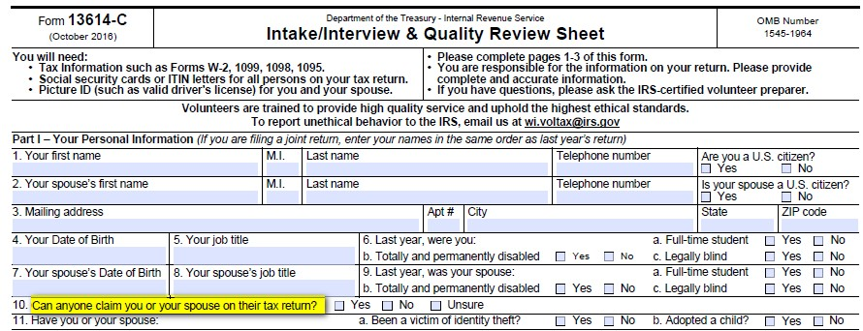
Intake/Interview
10. Can anyone claim you or your spouse on their tax return?

Slide 6
Note…
Dependents cannot claim exemptions for dependents
  Taxpayers who can be claimed as a dependent on someone else’s return cannot claim any exemptions for themselves or their own dependents
Pub 4012 – page C-1

Slide 7
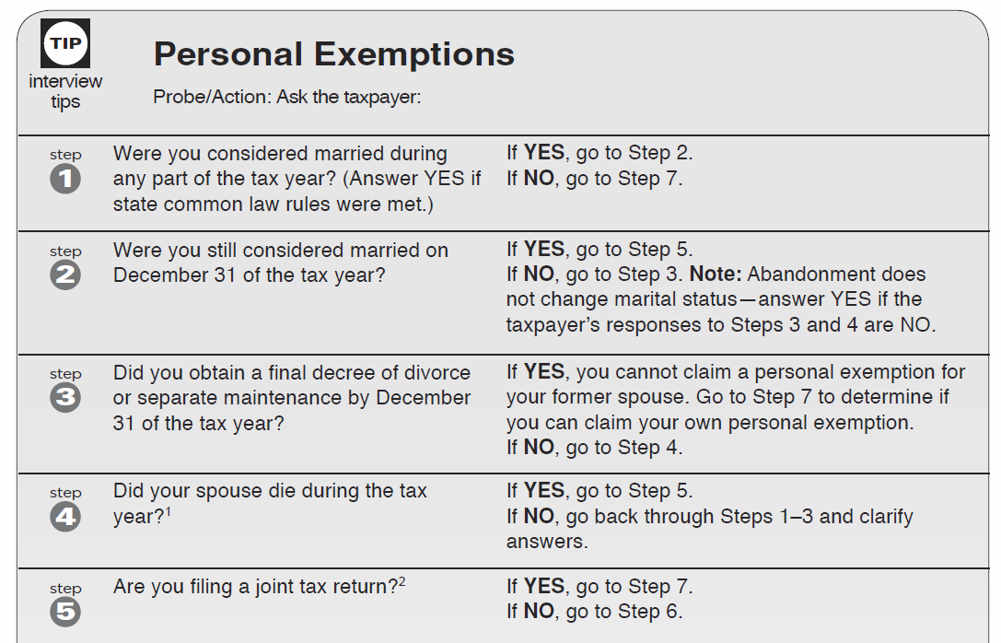
Personal Exemptions: Probe/Action
Pub 4012 – Page C-2
Notes:
If Single – Step 1 = No, go to Step 7

Slide 8

Personal Exemptions
One for taxpayer and one for spouse when filing jointly
Taxpayer or spouse is ineligible if another can claim him/her as a dependent
Notes:
Bullet 2 says IF and does not give an option.
This applies separately to each spouse. If one spouse can be claimed as a dependent, return cannot include his/her personal exemption, but it can include the exemption for the other spouse.

Slide 9
Personal Exemptions
Widow/er can file MFJ and claim two personal exemptions in year of spouse’s death
  If not remarried by 12/31
  If not divorced or legally separated on date of death
MFS can claim spouse – If no gross income and not dependent of another taxpayer
Notes:
If remarried and divorced before Dec 31, cannot file MFJ

Slide 10
Personal Exemptions
Questions?
Comments…

Slide 11
Dependent Exemptions

Slide 12
Dependent Exemption
Person other than taxpayer or spouse who entitles taxpayer to exemption:
  Qualifying child (which also includes adult with disability)
  OR
  Qualifying relative (which also includes qualifying non-relatives)
Notes:
Avoid listing the disability first and then the person.
e.g. boy with autism vs . autistic boy
People with disabilities want to be seen as a person first with the physical challenge(s) they may have second.

Slide 13
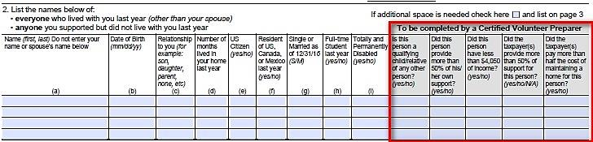
Intake and Interview
Ask: Is everyone listed who lived with you or whom you supported?
As necessary, get answers to questions in grey boxes and record them on the form

Slide 14
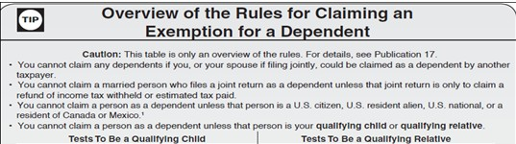
Dependency Exemption Rules
Turn to Pub 4012 page C-3
Overview of the Rules for Claiming an Exemption for a Dependent

Slide 15
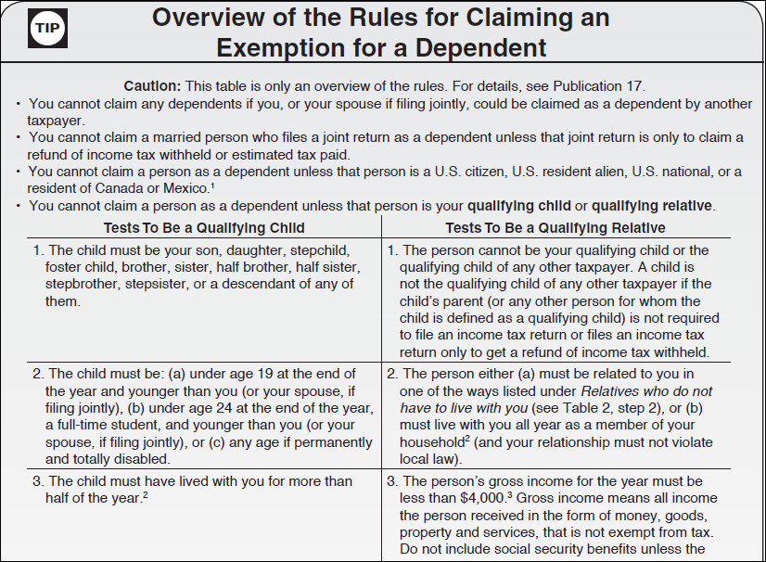
General Rules
You cannot claim a person as a dependent unless that person is your qualifying child or qualifying relative.
You cannot claim a married person who files a joint return as a dependent unless that joint return is filed only to claim a refund of withheld income tax or estimated tax paid.
You cannot claim a person as a dependent unless that person is a U.S. citizen, U.S. resident alien, U.S. national, or a resident of Canada or Mexico.
You cannot claim any dependents if you, or your spouse if filing jointly, could be claimed as a dependent by another taxpayer.

Slide 16
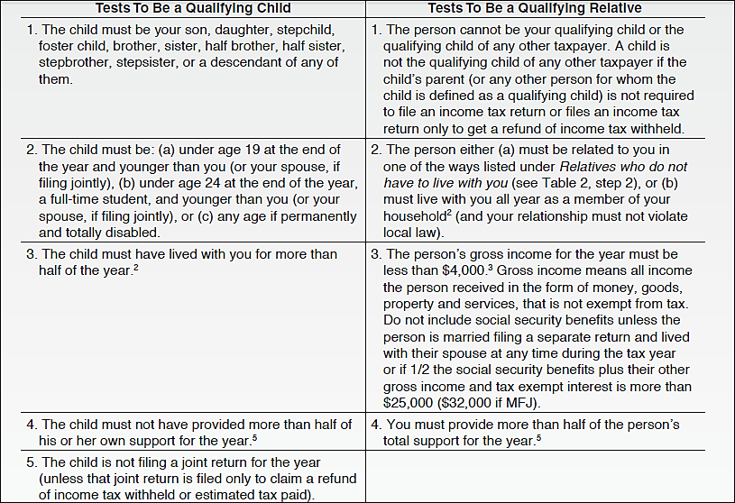
Tests to be a Qualifying Child

Slide 17
Terms
Permanently and totally disabled
  Person cannot engage in any substantial gainful activity because of a physical or mental condition -AND-
  Doctor determines condition has lasted or can be expected to last continuously for at least a year or can lead to death

Slide 18
Terms cont.
Student
  A full-time student during some part of each of any five calendar months of the year
  Full-time is the number of hours or courses the school considers to be full-time

Slide 19
Terms cont.
Student cont.
  Attending a school that has a regular teaching staff, course of study and student body at the school
  Does NOT include on-the-job training course, correspondence school, or school offering courses only through the Internet
Notes:
Elementary, junior or senior high school, college, university, or technical, trade, or mechanical school
See Definition of a school
Pub 17, Chapter 3 Personal Exemptions and Dependents page 28
School defined and
Vocational high school students (co-op jobs in private industry…..)

Slide 20
Terms cont.
Temporary absence
  Circumstances such as illness, education, business, vacation, or military service
  Must be reasonable to assume the absent person will return
  Must continue to keep up the home during the absence

Slide 21
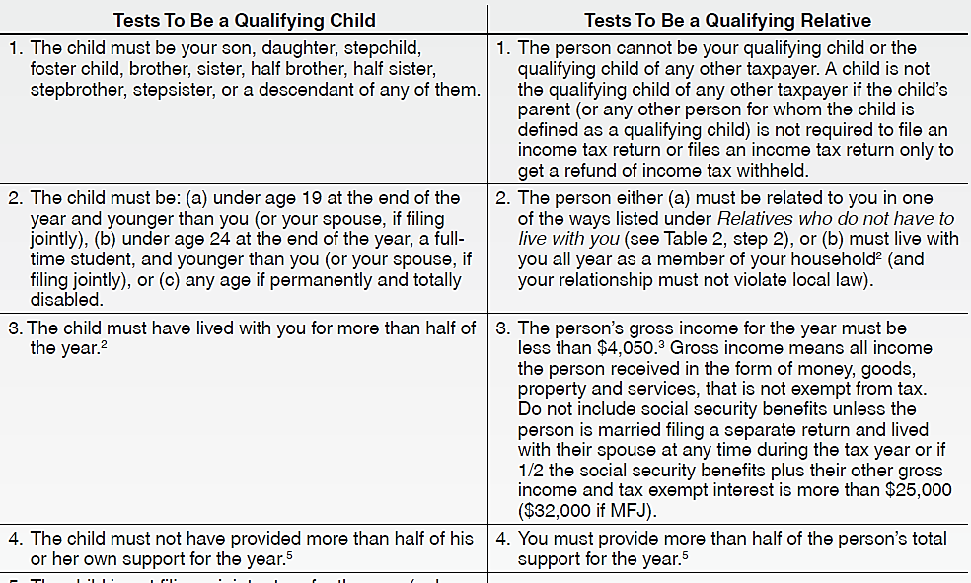
Tests to be a
Qualifying Relative

Slide 22
Tests to be a Qualifying Relative
Not a qualifying child test
Member of household or relationship test
Gross income test
Support test
Cannot be your qualifying child or the qualifying child of any other taxpayer
  See Pub 4012 Page C-6 for list
Be a member of your household all year, or
Be related to you in one of the following ways:
  Your child, stepchild, foster child, or a descendant of any of them
  Your brother, sister, half brother, half sister, stepbrother or stepsister
  Your father, mother or other direct ancestor, but not foster parent
  Your stepfather or stepmother
  A son or daughter of your brother, sister, half brother or half sister
  A brother or sister of your father or mother
  Your son-in-law, daughter-in-law, father-in-law, mother-in-law, brother-in-law or sister-in-law
Person’s gross income must be less than $4,050. (includes all income except that which is tax-exempt, such as social security benefits)
Taxpayer must provide more than 50% of the person’s support
Exceptions for:
  Children of divorced or separated parents
  Multiple support agreement
Notes:
Gross income defined. Gross income is all income in the form of money, property, and services that is not exempt from tax.

Slide 23
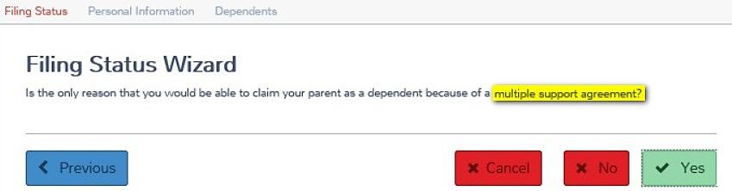
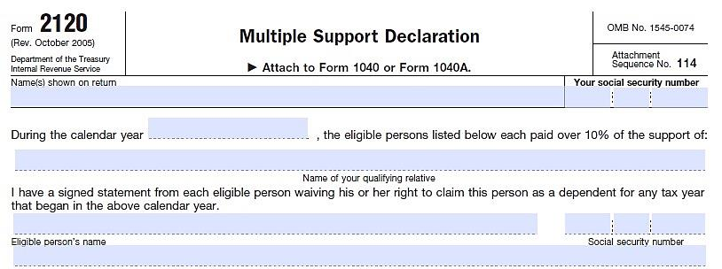
Special Attention
Qualifying child of more than one taxpayer
SSN, ITIN or ATIN is required for all
Form 2120–Multiple support agreements question
Notes:
23
TaxSlayer reports that they currently do not support the 2120. There is a question about it in the Filing Status wizard, but it is not functional.
Purpose of Form
Identify each other eligible person who paid over 10% of the support of your qualifying relative whom you are claiming as a dependent AND
Indicate that you have a signed statement from each other eligible person waiving his or her right to claim that person as a dependent

Slide 24
Form 2120 – Multiple Support Agreement
Space saver
  TaxSlayer improves / changes its handling of 2120.
  Updated directions

Slide 25
QC of More Than One Taxpayer
Pub 4012 pg C-4
Pub 17 pg 234
Who can claim the child if two taxpayers have the same qualifying child?
  If only one is a parent – the parent
  If both are parents, the one with whom the child lived the greater number of nights
  If both parents claim the child, the parent with higher Adjusted Gross Income (AGI)
Notes:
NOTICE: Rule 2 and 3 are voluntary. If both parents agree, the IRS doesn’t care which parent claims the child—so long as the claiming parent had custody more than six months
When parents are divorced or separated
Only one taxpayer can actually treat the child as a qualifying child.
Only that person can use the child as a qualifying child to take all of the following tax benefits (provided the person is eligible for each benefit).
The exemption for the child.
The child tax credit.
Head of household filing status.
The credit for child and dependent care expenses.
The exclusion for dependent care benefits
The EIC
The other person cannot take any of these benefits based on this qualifying child. In other words, the two taxpayers cannot agree to divide these tax benefits between each other.

Slide 26
QC of More Than One TP cont.
Pub 4012 pg C-4
  If a parent could claim the child but doesn’t, the household (and family) member with the highest AGI
  If neither are parents, the person with the highest AGI
Notes:
Go in order and stop as soon as a rule is satisfied

Slide 27
Uniform Definition of a QC
Only one person can treat the child as a QC for all the following benefits (provided the person is eligible for each):
  Dependency exemption
  Head of household filing status
  Earned Income Credit
  Child Tax Credit
  Child/Dependent Care Credit
  Exclusion for Dependent Care Benefits

Slide 28
Child of Separated Parents
Limited situation
  Parents are divorced or legally separated or lived apart the last half of the year
  Child was in custody of one or both parents more than ½ the year
  At least ½ child’s support was provided by one or both parents (or step-parents)

Slide 29
Child of Separated Parents
Agreement
  Pre-2009 divorce decree
  Form 8332 or similar
Allows non-custodial parent to claim some benefits based on the child, while custodial parent retains other benefits
Without an agreement, custodial parent claims the child
Notes:
Divorce decree must give the noncustodial parent the right to claim the child’s exemption without any conditions, such as payment of support.
Special rules apply if decree is dated before 1984.

Slide 30
Child of Separated Parents
Non-custodial parent can claim:
  Dependency exemption
  Child tax credit
  Education credits
  Premium tax credit
  Medical expenses that he or she paid

Slide 31
Child of Separated Parents
Custodial parent can claim:
  Head of household filing status
  Dependent care credit
  Earned income credit
  Medical expenses that he or she paid

Slide 32
Terms cont.
Custodial and noncustodial parent
  Custodial parent is parent with whom the child lived for the greater number of nights during the year
  If the child lived with each parent for an equal number of nights, the custodial parent is the parent with the higher adjusted gross income

Slide 33
Problem #1
Richard, a widower for three years, and his two young sons lived with Richard’s mother Mary for the entire tax year
Richard and Mary equally share the support of the two sons
Richard’s income was $38,000 and Mary’s income was $35,000
  See Example on Page C-4 Pub 4012 and
  Example #2 on page 31 Pub 17
Notes:
See “Qualifying Child of More than One Person, lower left box.
Mary could claim dependency only if the parent declined, and her AGI exceeded that of the parent.
See Example #2 on page 31 of Pub 17.

Slide 34
Problem #1 cont.
Can Richard “give” the dependency of his children to his mother?
No – He has the higher AGI.

Slide 35
Definition of Support
Generally, food, lodging, clothing, education, medical and dental care, recreation, transportation, and similar necessities
Social Security benefits received in child’s name are considered as paid by child
Welfare is considered paid by 3rd party (e.g., State) rather than by dependent
(see footnote for Step 8 on Pub 4012 C-5)
Notes:
See Worksheet 3-1, page 30 in Pub 17 (Worksheet for Determining Support).
Community income (e.g. community property states) is split and provided by each spouse 50/50

Slide 36
Support – Pub 4012: Tab C
Worksheet for Determining Support – page C-9 Pub 4012
If applicable, see Table 3 on rules for parents who are divorced or separated (or never married) – Form 8332 may be required
Notes:
Pub 4012 C-8, Table 3: Children of Divorced or Separated Parents or Parents Who Live Apart.
See footnote 2 with mention of Form 8332.
Form 8332 is also mentioned in the following footnotes:
Release of exemption revoked
Other decrees or agreements that do not meet step 4

Slide 37
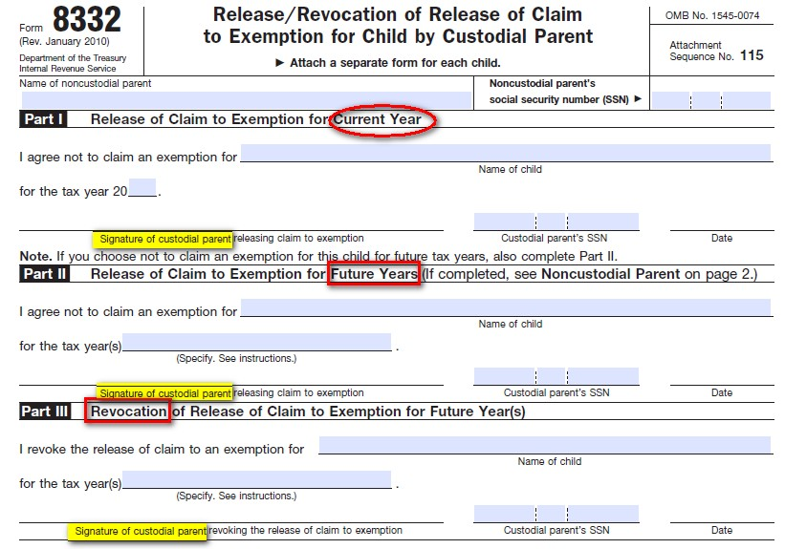
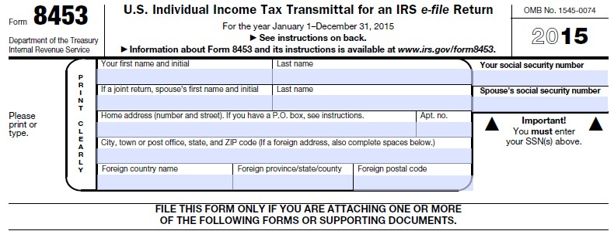
Support – Form 8332
See speaker note
Attach 8332
To Form 8453
2016
Notes:
Screen Saver:
TaxSlayer reports that they have the ability to upload a PDF of the 8332.
TS already supports the use of the 8332, and it currently generates the 8453 in Production and NOT in Practice Lab.
I agree that we need to wait for Form 8332 to be available and to include how to access Form 8332. That is NOT currently available.
Add slide with screen shots of how to access Form 8332 once those pictures are available. That will probably result in the alteration of this slide.
Ellen

Slide 38
Support
Note that support tests are different!
  For Qualifying Child, rule is that child DID NOT provide more than half of his or her own support
  For Qualifying Relative, rule is that taxpayer DID provide more than half of that person’s support

Slide 39
Multiple Support
Pub 17 – page 36
Multiple Support Declaration, Form 2120, required if:
  Several people together provide >50% of support
  Taxpayer provided at least 10% of support
The Declaration states who may claim dependent exemption
Notes:
39
Pub 17 – Page 36, Multiple Support Agreement, referencing Form 2120.
Form 2120 is required and says the following:
It is used to determine who paid over 10% of the support of your qualifying relative whom you are claiming as a dependent. Each statement must be signed. If there are more than 4 other eligible persons, attach a statement to your return with the required information.
The “several people together” cannot include the dependent.
06exemptions2008x2

Slide 40
Problem #2
John supports his wife’s Uncle George who lives in another city and has $3,600 of taxable income. John files MFJ.
Can John claim George as a dependent if all other tests met?
Yes – Passes relationship, income, and support tests
Notes:
Let them read the problems and think about them. Then go through them one at a time.
Table 2, step 2 – also note in right hand column.
(Use Table on Dependency Exemption for Qualifying Relatives to answer – C-5.)
Step 1, No – Not a qualifying child; Step 2, Yes – an uncle; Step 4, Yes - a citizen; Step 5, yes – income less than $3700; and passes all other tests.
Relatives who do not have to live with you – Pub 17, pg. 32.

Slide 41
Problem #2, Continued
What if John is divorced?
Would he still be able to claim his wife’s Uncle George?
NO – His wife’s uncle is not the “sibling of your parent” and therefore not a “qualified in-law”
Pub 17 – page 33
Notes:
Table 2, step 2.
Applicable In-Laws: Pub 17 – page 33
Found by looking up “Qualifying Relative” starting on page 22.
In-law relationships are limited to parents, children or siblings.

Slide 42
Problem #3
John is also supporting his own cousin who earned $3,560 and lives in another city.
Can John claim him?
NO – Cousin is not a qualifying relation
Notes:
Table 2, Step 2.
The most distant non-resident qualifying person is the child of a brother or sister, i.e., a niece or nephew.

Slide 43
Problem #4
Ralph is 64 and lives with his son and daughter-in-law all year
Ralph earned $4,075
Can Ralph’s son claim him as a dependent?
NO – Income over $4,050
Notes:
Table 2 – Step 5.

Slide 44
Problem #5
Ralph’s son is also supporting his friend, Fred, who lives with them
Fred’s only income is social security of $5,000
Can Fred be claimed?
Yes, as long as Fred lived with him ALL YEAR. The gross income test does not count income that is exempt from tax
Notes:
44
Walk through Table 2.

Slide 45
Tax Law Summary
A non-related person can be a dependent
A non-dependent can qualify for EIC and Child Care Credit
The resource materials are essential to determine number of exemptions
Notes:
Walk through Table 2.

Slide 46
Intake and Interview

Slide 47
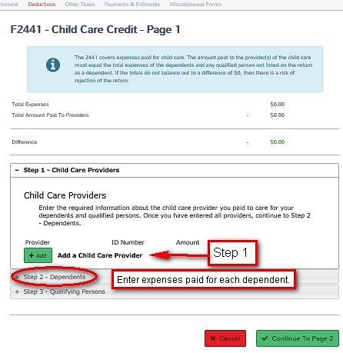
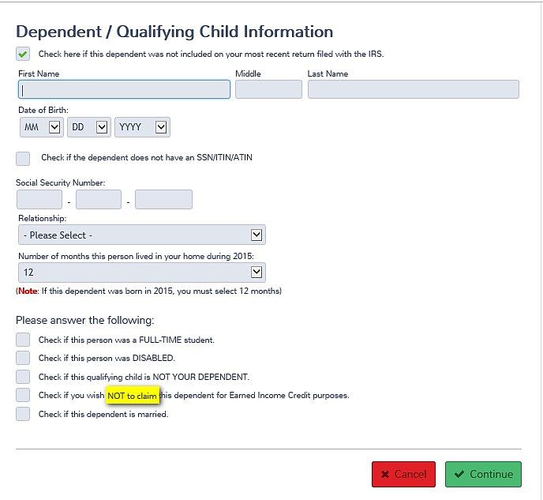
Dependents In TaxSlayer
1 CTC, 2 CDC, and 3 EIC
1) Child Tax Credit – Populated by TaxSlayer
2) Child (Dependent) Care Credit
3) Earned Income Credit – Not being claimed.
Notes:
Identifies where one can find CTC, CDC, and EIC in TaxSlayer.

Slide 48
Entering Dependent / Qualifying Child Information in TaxSlayer
Does the dependent
have a SSN/ITIN/ATIN?
No?
See next slide.
Is the birthday is correct..
Does the relationship make
him or her a qualifying child?
Did the child live with the
Taxpayer more than ½ the
Year?
Check if you wish
NOT to claim the
dependent for EIC
Purposes.
Notes:
Note the check box is to NOT CLAIM the dependent for EIC purposes.
This conflicts with Pub 4491 Tab 30-5 which says List children from youngest to oldest in the software AND check the EIC box.
Pub 4491 should say check the EIC box if the taxpayer does not qualify for EIC.

Slide 49
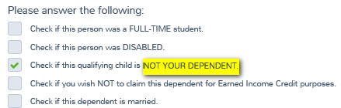
Dependents In TaxSlayer
Dependents
Non-dependents
Is the qualifying child a dependent or a non-dependent
Dependent / Qualifying Child Information
EIC, Dependent Care qualifiers
Notes:
There is no support test for EIC for a qualifying child, but there is a support test to be claimed as a dependent.

Slide 50
Qualifying Child Tri-Fold
Notes:
How many use a chart for single or MFJ?

Slide 51
Qualifying Child Tri-Fold
A better tool for a comprehensive, clearer answer
  If a family or household member isn’t a dependent, sometimes not included on tax return...
...even when s/he should be included as a non-dependent for EIC, DC, or other benefits

Slide 52
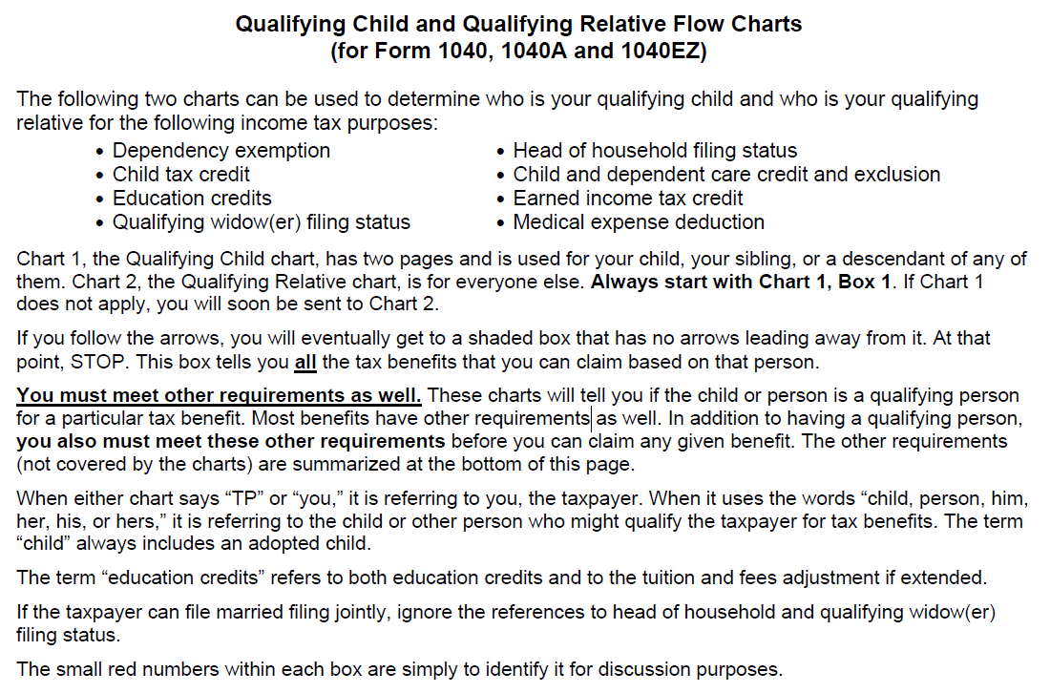
Read the Introductory Page
Notes:
Covers eight tax benefits. Does not cover student loans.
Charts tell if you have a qualifying child, but there are also OTHER REQUIREMENTS.
Taxpayer is referred to as “you.” Child or other person is referred to as “him” or “her.”

Slide 53
Start with Qualifying Child Chart
Use one taxpayer (or a taxpayer couple if filing MFJ) – referred to as “you”
And one child or other person – referred to as “him” or “her”
Use the child’s name when asking the questions
Notes:
If taxpayer is filing MFJ, questions refer to either the taxpayer or the spouse.

Slide 54
Use the Child’s Name
If the child’s name is Joe,
  Start at Box 1 and ask,
  “Was Joe a U.S. citizen or national or a resident of the U.S., Mexico or Canada
  For some part of the tax year?”

Slide 55
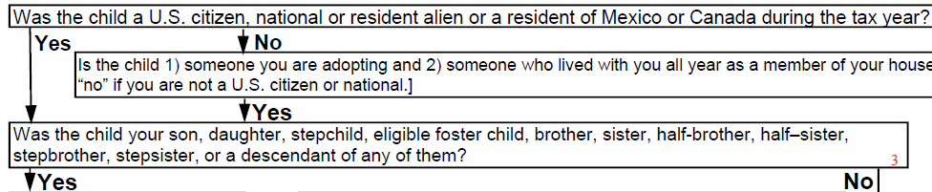
Follow the arrows
If the answer to the question in Box 1 is “yes,” follow the yes arrow to Box 3.

Slide 56
Box 3
Ask, “Was Joe your son, daughter, stepchild, eligible foster child, brother, sister, half-brother, half-sister, stepbrother, stepsister, or a descendant of any of them?”

Slide 57
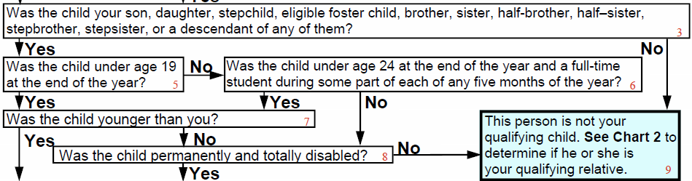
Follow the arrows
If the answer to the question in Box 3 is “yes,” follow the yes arrow to Box 5
And ask the question in Box 5

Slide 58
Blue boxes
When you get to a blue box, STOP
The blue box lists ALL the benefits for which this child qualifies the taxpayer
Read the whole box
  Important information is included in parentheses after most benefits

Slide 59
Repeat for Other Children
You may get to a different blue box
  If there is an additional child
    Household member or
    Family member
  Whose situation is different

Slide 60
Start with the Middle Generation
If the household has multiple generations,
  Don’t start with the grandchildren
  Start with the children
You’ll need to determine
  If the children ARE dependents
  before you can determine
  If the children HAVE dependents

Slide 61
Start with Qualifying Child Chart
Always start with the Qualifying Child Chart (Chart 1) –
  You will be directed to Qualifying Relative Chart (Chart 2) if appropriate
Easy to mistake child of a non-custodial parent
  As a qualifying relative –
  Always start with the Qualifying Child Chart

Slide 62
It looks very complicated, but...
If child’s situation is straight-forward, the chart will take you straight down the left-hand side
  To Box 29 which asks
  Same questions you would answer from Page C-3 of the Resource Guide

Slide 63
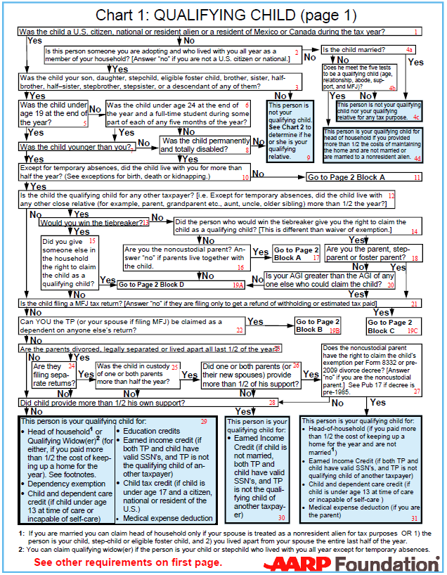
Citizenship?
Relationship?
Age?
Younger than you?
Residency?
Child of more than
one person?
Child filing MFJ?
Can you be claimed as a dependent?
Parent separated and filing separate returns?
Did the child provide more than ½ of his own support?
Then, person is qualifying
person for all possible benefits

Slide 64
If situation is not straight-forward
Follow the arrows to arrive at correct answer

Slide 65
Problem #6
Child (John) is self-supporting (because he receives social security survivor benefits used for his support)

Slide 66
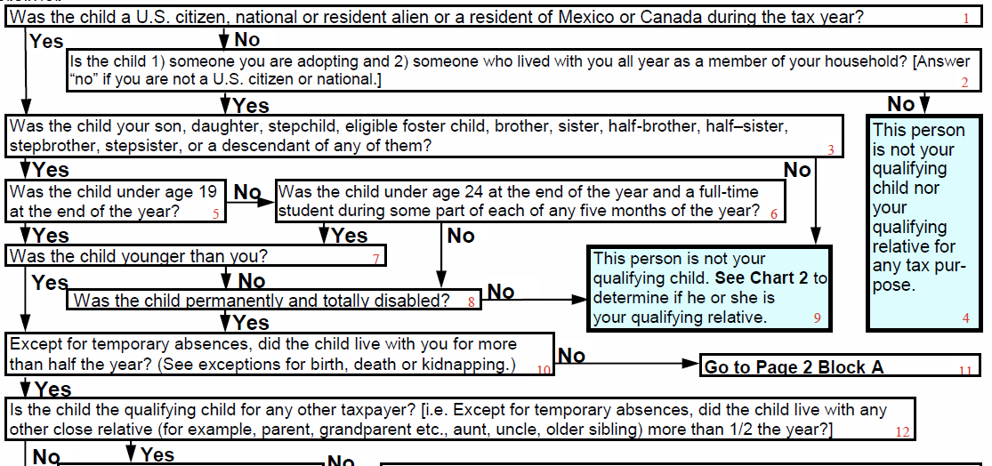
Start with John as QC of parents
Ask: Was John a US citizen or national or a resident alien of the US, Mexico or Canada for some part of the tax year?
Ask: Was John your son, daughter, stepchild, eligible foster child, brother, sister, half-brother, half-sister, stepbrother, stepsister, or a descendant of any of them?
Ask: Was John under age 19 at the end of the year
Ask: Was John younger than you?
Ask: Except for temporary absences, did John live with you for more than half the year? (See exceptions for birth, death or kidnapping.)
Ask: Is John the qualifying child for any other taxpayer? [i.e. Did John live with any other close relative (for example, parent, grandparent etc., aunt, uncle, older sibling)] for more than ½ the year?

Slide 67
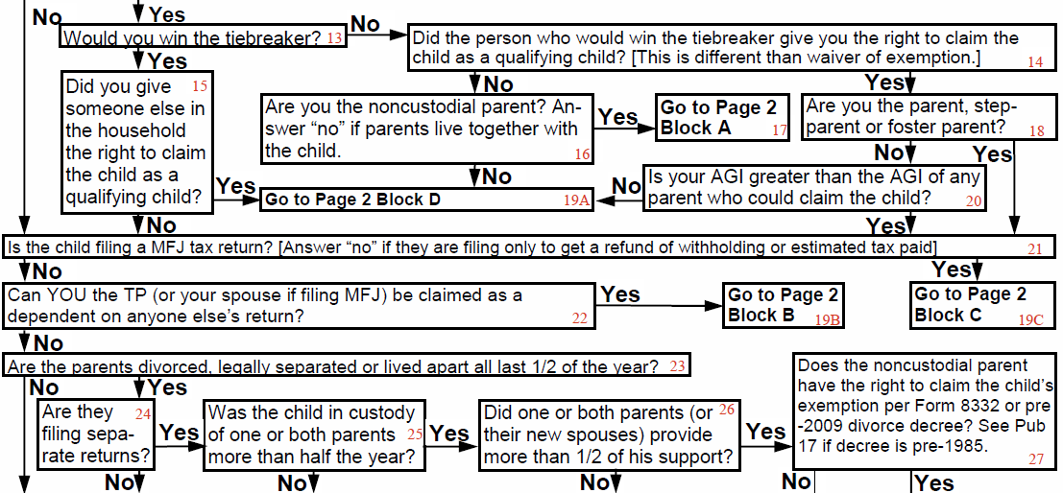
Continue with John as QC of parents
Ask: Is John filing a MFJ tax return? [Answer “no” if filing only to get a refund of withholding or estimated tax paid.]
Ask: Can you, the taxpayer, be claimed as a dependent on anyone else’s return?
Ask: Are John’s parents divorced, legally separated or lived apart all last ½ of the year?

Slide 68
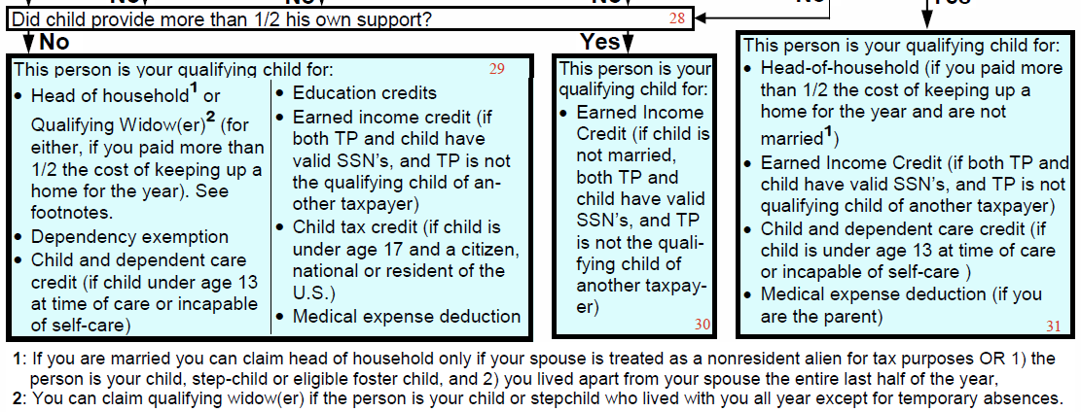
Continue with John as QC of parents
Ask: Did John provide more than ½ his own support?
John is your qualifying child for earned income credit IF
He is not married,
Both you and he have valid SSNs, and
You are not the qualifying child of another person.

Slide 69
Continue with John as QC of parents
But note:
No head of household
No dependency exemption
No child tax credit, etc.

Slide 70
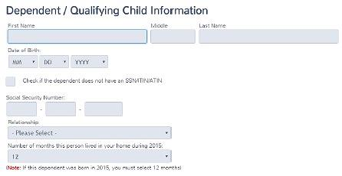

Enter John as a non-dependent

Slide 71
Problem #7
Taxpayer (Tom) pays child support and pays for medical insurance for his child (Billy), but his ex-wife won’t sign Form 8332.

Slide 72
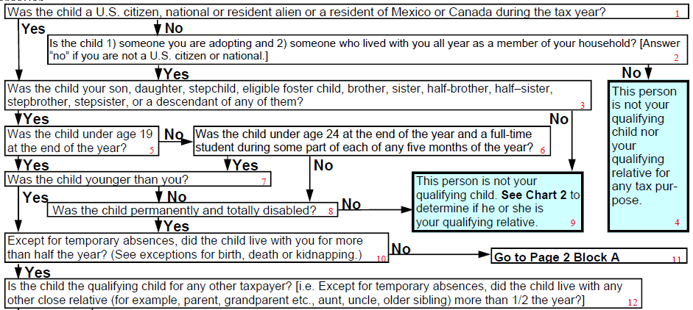
Start with Billy as QC of Tom
Ask: Was Billy a US citizen or national or a resident alien of the US, Mexico or Canada for some part of the tax year?
Ask: Was Billy your son, daughter, stepchild, eligible foster child, brother, sister, half-brother, half-sister, stepbrother, stepsister, or a descendant of any of them?
Ask: Was Billy under age 19 at the end of the year?
Ask: Was Billy younger than you?
Ask: Except for temporary absences, did Billy live with you for more than half the year? (See exceptions for birth, death or kidnapping.)
Go to Page 2 Block A

Slide 73
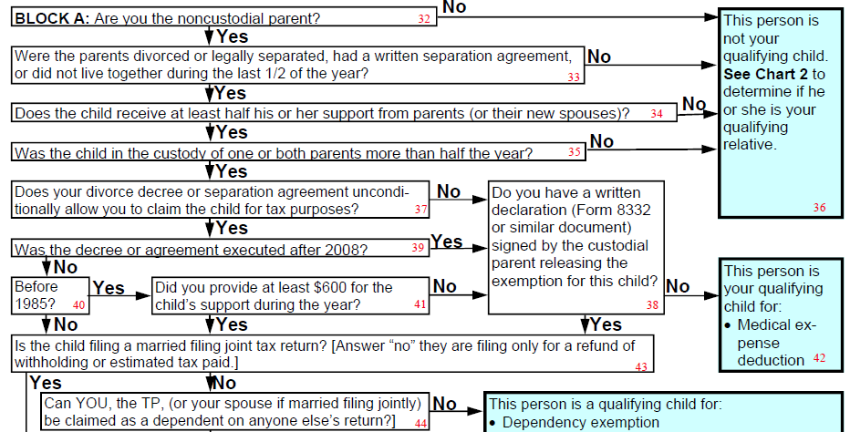
Continue in Block A (Billy as QC of Tom)
Do not include Billy as Dependent or Nondependent, but do include his medical expenses on Sch A
Are you the noncustodial parent?
Were the parents divorced or legally separated, had a separate maintenance agreement, or did not live together during the last ½ of the year?
Does Billy receive at least half his support from parents or their new spouses?
Was Billy in the custody of one or both parents more than half the year?
Does your divorce decree or separation agreement unconditionally allow you to claim Billy for tax purposes?
Do you have a written declaration (Form 8332 or similar document) signed by the custodial parent releasing the exemption for Billy?

Slide 74
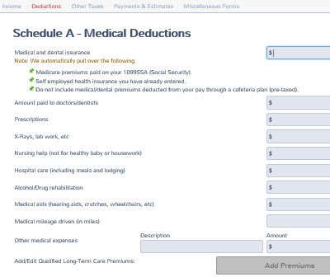
Billy
Claim on Sch A Medical Deductions

Slide 75
Problem #8
Jennifer, age 25, is a full-time student who lived at home with her parents all year
Jennifer made $3,000 and her parents provided over half of her support
Can Jennifer's parents claim her as a dependent?

Slide 76
Problem # 8 Answer
Is Jennifer a Qualifying Child?
NO – She satisfies the residency and relationship tests, but not the age test
If Jennifer is not a Qualifying Child, is she a Qualifying Relative?

Slide 77
Problem #8 Answer
Is Jennifer a Qualifying Relative?
YES
  She is their daughter
  She earned less than $4,050
  Parents provided >50% support
  Not the Qualifying Child of anyone
  Can be claimed if all other tests met

Slide 78
Problem #9
Stacy has a son, Ben, age 14, and they lived with Stacy's boyfriend, Bob (who is not Ben's father) all year
Stacy earned $7,000 and Bob earned $50,000
Can Bob claim Ben as a dependent?

Slide 79
Problem #9 – Answers
NO – If Stacy files a return
  Ben would be a Qualifying Child of Stacy
YES – If Stacy does not file a return OR files ONLY to get a refund of withholding
  Ben could be a Qualifying Relative Dependent of Stacy’s boyfriend
  It might be more beneficial, however, for Stacy to file for EIC

Slide 80
Verify
Counselors have updated laminated tri-fold
Or they have manually made the minor edits to their older version of the tool
Can also print from OSHC

Slide 81
Multiple Uses of Dependent Info
Dependent
Dependent care
Earned Income Credit
Child Tax Credit
Education Credit
Premium Tax Credit
Medical expenses
Notes:
Step through showing how the data will be used.
Go to Pub 4012, page G-8

Slide 82
Quality Review
Confirm that everyone who lived with taxpayer or who was supported by taxpayer is listed on Intake/Interview Sheet
  Determine if dependent or non-dependent is eligible for EIC, DC, or other benefits

Slide 83
Exit Interview
May need to
  Review who is or is not dependent and why
  Explain benefits

Slide 84
Summary
Pub 4012 Tab C
  If you have questions
  Multiple support
  Divorced or separated parents
  Read table footnotes for exceptions
Dependency is usually obvious – but not always!
Notes:
84
06exemptions2008x2

Slide 85

Exemptions
Questions?
There goes the last dependent?
Comments…
Notes:
Explain that this is probably the hardest thing in doing taxes, but there is lots of help available in materials as well as other Volunteers.

